Slide 1
DoH
DNS over HTTPS
January 2021
Yishay Garame, David Chitiz, Alon Perlmuter

Slide 2
DNS over HTTPS
DNS
HTTPS
HTTP
TLS
HTTP1.0
HTTP1.1
HTTP2.0

Slide 3
DNS
DNS over HTTPS
DNS
HTTPS
HTTP
TLS
HTTP1.0
HTTP1.1
HTTP2.0

Slide 4
DNS - Domain Name System
The Domain Name System (DNS) is a central part of the internet, providing a way to match names (a website you’re seeking) to numbers (IP addresses).
When we type some website domain (example.com.) into our browser, our browser sends a query over the internet to find the IP address of the domain we just entered.
The first server our query interacts with is the recursive resolver, which can be operated by our ISP, wireless carrier or a third-party provider. The recursive resolver knows which other DNS servers it needs to ask to answer our original query (what is the IP address of example.com?).
The first type of DNS server the recursive resolver talks to, is named a Root Server (.) .
The Root servers are running all over the world and each one knows the DNS information about
Top-Level Domains such as .com, .net, .org etc.
There are 13 sets of Root Servers around the world

Slide 5
DNS-Domain Name System
Each Top-Level Domain (TLD) server stores the address information for second level domains (example.com) within the top-level domain (.com). When our query reaches the TLD server, the TLD server answers with the IP address of the Authoritative Nameserver (example.com).
Finally, the recursive resolver sends the query to the Authoritative Nameserver. The Authoritative Nameserver knows the IP address for the full domain (example.com), and that answer is returned to the recursive resolver and then to our browser.

Slide 6
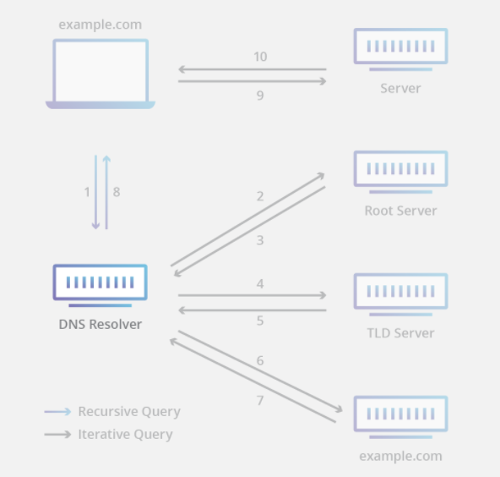
DNS-Domain Name System
root DNS server
2
local DNS server
dns.poly.edu
3
TLD DNS server
4
5
7
6
1
8
authoritative DNS server
dns.cs.umass.edu
requesting host
cis.poly.edu
gaia.cs.umass.edu

Slide 7
Unencrypted DNS
Ever since DNS was created, it has been largely unencrypted. Everyone between your device and the resolver can snoop on or even modify your DNS queries and responses. This includes anyone in your local Wi-Fi network, your Internet Service Provider (ISP), and transit providers. This may affect your privacy by revealing the domain names that are you are visiting.

Slide 8
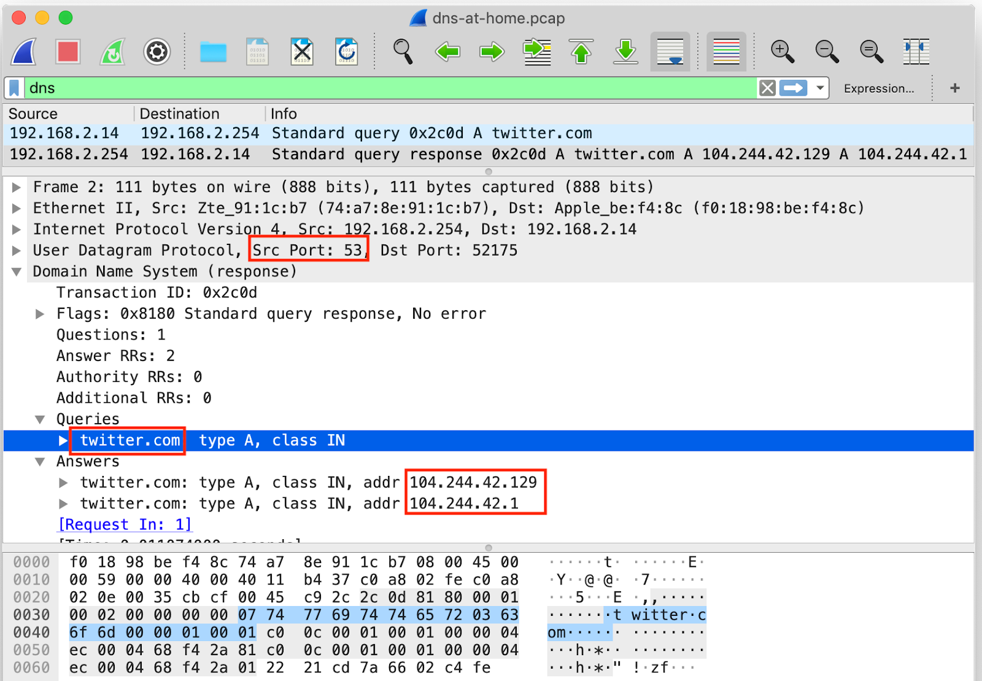
Unencrypted DNS
The following observations can be made:
The UDP source port is 53 which is the standard port number for unencrypted DNS. The UDP payload is therefore likely to be a DNS answer, that suggests that the source IP address 192.168.2.254 is a DNS resolver while the destination IP 192.168.2.14 is the DNS client.
The UDP payload could indeed be parsed as a DNS answer, and reveals that the user was trying to visit twitter.com.

Slide 9
Unencrypted DNS
If there are any future connections to 104.244.42.129 or 104.244.42.1, then it is most likely traffic that is directed at “twitter.com”.
If there is some further encrypted HTTPS traffic to this IP, succeeded by more DNS queries, it could indicate that a web browser loaded additional resources from that page. That could potentially reveal the pages that a user was looking at while visiting twitter.com.

Slide 10
HTTP
DNS over HTTPS
DNS
HTTPS
HTTP
TLS
HTTP1.0
HTTP1.1
HTTP2.0

Slide 11
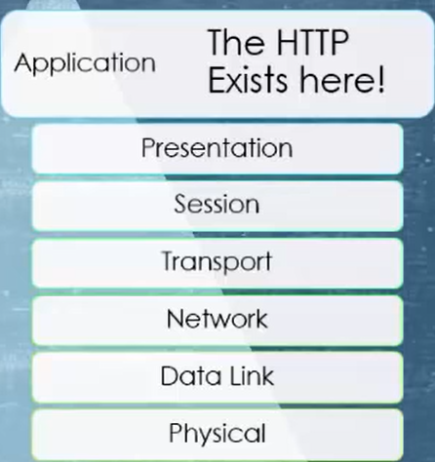
What is HTTP?
HTTP – HyperText Transfer Protocol
Http is the most used internet protocol in the world
Http is an application layer protocol that allows web-based applications to communicate and exchange data.
Communication between web servers & clients.
It is base on TCP\IP model.
Used to deliver Contents like videos, images, audio, documents etc.

Slide 12
Important things you should know about HTTP
In the beginning HTTP was connectionless –after the client made a request, the client disconnected from the server and when the server was ready to response the server re-established the connection .
HTTP can deliver any kind of data
HTTP is stateless – means that both the client and the server knows about each other only during the current request. When it closes and they want to connect again they need to provide information to each other like it’s the first time.

Slide 13
HTTP Request
HTTP request is a request line, followed by zero or more request headers
Request line: <Method>,<URI>,<Version>
• <Version> is HTTP version of request (e.g., HTTP/1.1)
•<uri> is typically URL for proxies, URL suffix for servers.
• <Method> is either GET, POST, OPTIONS, HEAD, PUT, DELETE, or TRACE.

Slide 14
HTTP Response
• HTTP response is a response line followed by zero or more response headers
Response line: <Version>,<Status Code>,<Status Message>
•<version> is HTTP version of the response.
• <Status Code> is numeric status.
• 1xx Informational 101 Switching Protocols
• 2xx Success 200 OK Request was handled without error
• 3xx Redirection 301 Moved Permanently
• 4xx Client Error 404 Not found Server couldn’t find the file
• 5xx Server Error 505 HTTP Version Not Supported
• <Status Message> is corresponding English text.
Response headers: :<Header Name>,<Header Data>
• Provide additional information about response
• Content-Type: MIME type of content in response body.
• Content-Length: Length of content in response body.

Slide 15
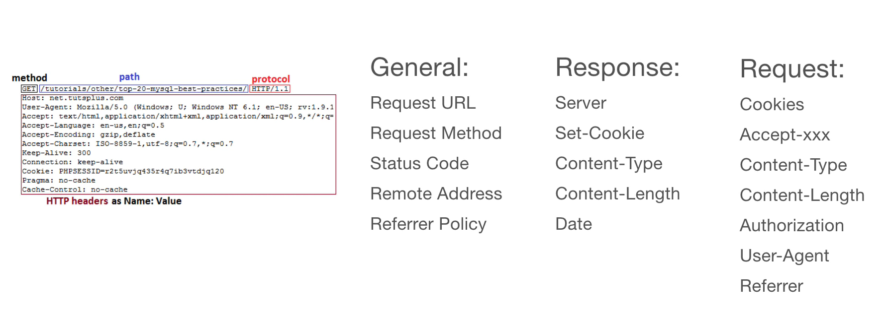
HTTP Header Fields

Slide 16
HTTP 1.0
DNS over HTTPS
DNS
HTTPS
HTTP
TLS
HTTP1.0
HTTP1.1
HTTP2.0
Non persistent:
Create a TCP connection, transfer one
object and than close the connection.
RTT: the time that takes to send a small package
from client to Server and back.
F: the size of the file
In this example T = 2RTT+F/R
The default is to close after request-response.
The TCP/IP connection will remain only if both client and server pass: "Connection: keep-alive"
initiate TCP
connection
RTT
request
file
RTT
file
received

Slide 17
HTTP 1.1
DNS over HTTPS
DNS
HTTPS
HTTP
TLS
HTTP1.0
HTTP1.1
HTTP2.0
TCP
Keeps the TCP connection with the server
open instead of closing it after every request.
In this example T = RTT + 4(RTT + F/R)
The default is to keep the connection. But it will be closed if at least one side,
either client or server, will pass:"Connection: close“.
request
Main page
Request Pic 1
Pic 1
Request Pic 2
Pic 2
Request Pic 3
Pic 3

Slide 18
HTTP 1.1 pipeline
TCP
pipeline allow you to send requests without waiting for you to get them.
In this example T = 2RTT + F/R + RTT + 3F/R
request
Main page
request
Pic 1,2,3
Pic 1,2,3

Slide 19
Slow page leads to:
Frustrated users
High Bounce Rates
Solution:
Reduce the number of HTTP requests.

Slide 20
HTTP 2.0
DNS over HTTPS
DNS
HTTPS
HTTP
TLS
HTTP1.0
HTTP1.1
HTTP2.0
Using a single TCP
The client “shoves” as many as requests he wants in the socket- multiplexing
How can the server match his response to a specific request?
How can the client match the server response to a specific request?
Answer : stream ID
It gives us to opportunity to compress headers and data

Slide 21
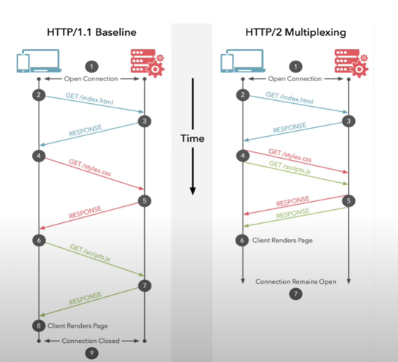
HTTP 2.0

Slide 22
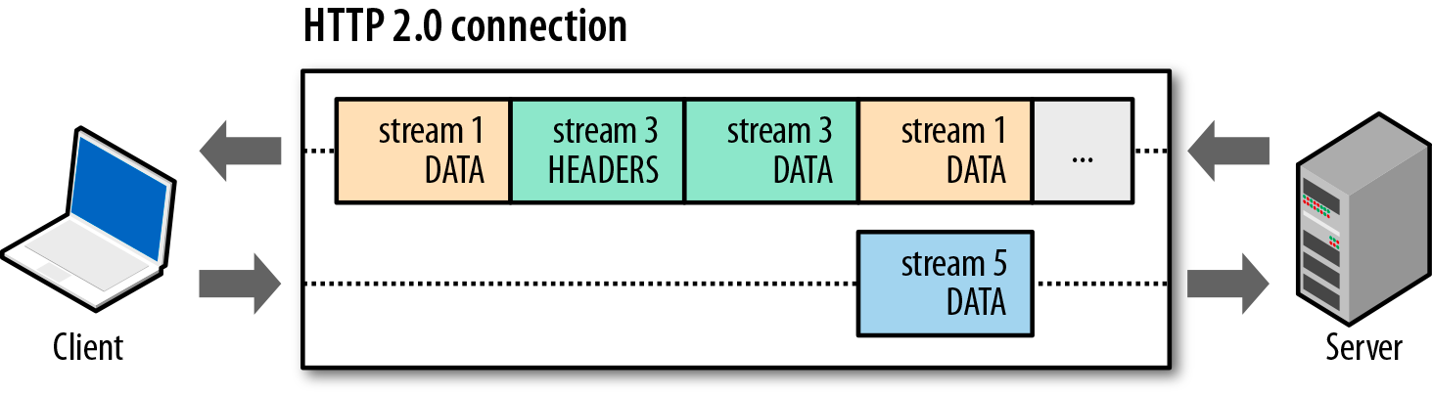
HTTP 2.0
Each packet will be tagged with stream id

Slide 23
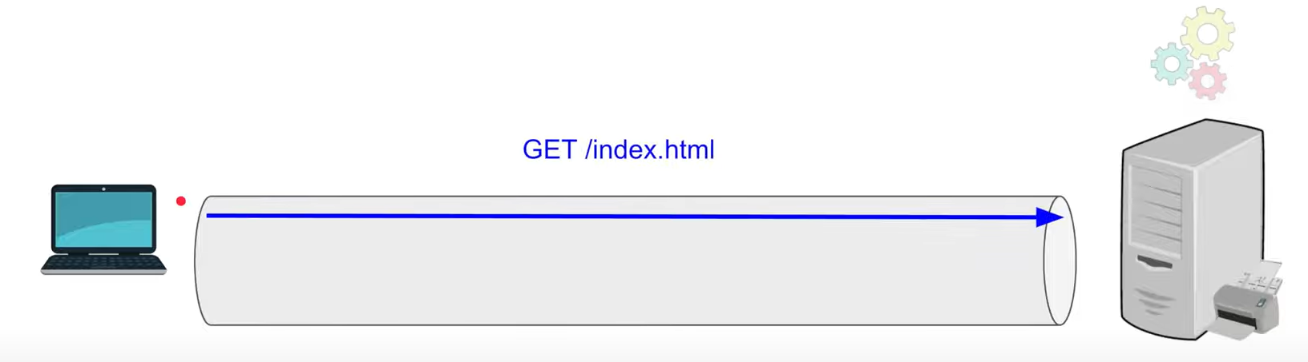
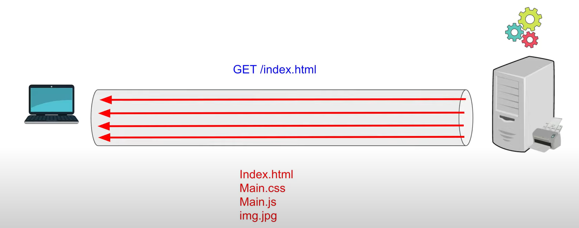
HTTP 2.0 with PUSH
http 2.0 also support “Push”:
Push means that if for example a client asks for an html page, the server is smart enough to understand that the client probably wants the images and the related files.
The Server will push the rest of the files with the response.

Slide 24
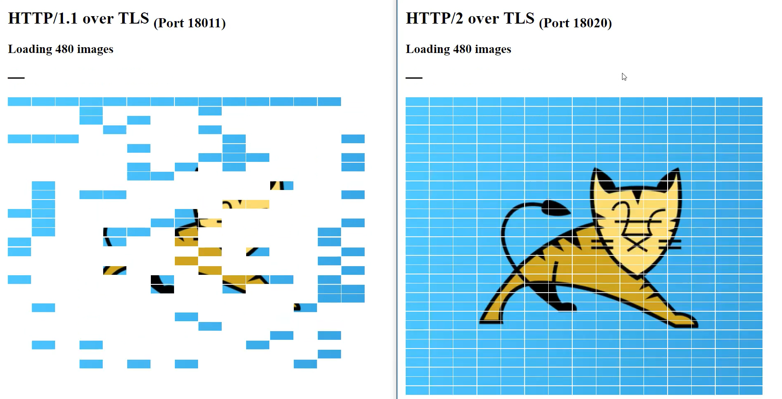
HTTP 1.1 Vs HTTP 2.0
This image represents how http1.1 and http 2.0 gets an image build from 480 small images from the web.
While http1.1 ask for each small image in http2.0 it ask ones and the rest is “pushing” to it.

Slide 25
HTTP 2.0
Multiplexing over single connection
Compression (headers and data)
Server push
Protocol negotiation during TLS (ALPN)
Flow control - ensures that only data that can be used by a receiver is transmitted.

Slide 26
To Conclude
HTTP/1.1 without pipelining: Each HTTP request over the TCP connection must be responded to before the next request can be made.
HTTP/1.1 with pipelining: Each HTTP request over the TCP connection may be made immediately without waiting for the previous request's response to return. The responses will come back in the same order.
HTTP/2 multiplexing: Each HTTP request over the TCP connection may be made immediately without waiting for the previous response to come back. The responses may come back in any order.

Slide 27
TLS
DNS over HTTPS
DNS
HTTPS
HTTP
TLS
HTTP1.0
HTTP1.1
HTTP2.0

Slide 28

TLS
TLS is a cryptographic protocol that provides end-to-end security of data sent between applications over the Internet.
TLS evolved from Secure Socket Layers (SSL)
TLS does not secure data on end systems it simply ensures the secure delivery of data over the internet.
Without TLS, sensitive information such as logins, credit card details and personal details can easily be seen by others.

Slide 29




?

Slide 30
How does TLS work?
TLS uses a combination of symmetric and asymmetric cryptography (single key and a pair of public key and a privates).

Slide 31
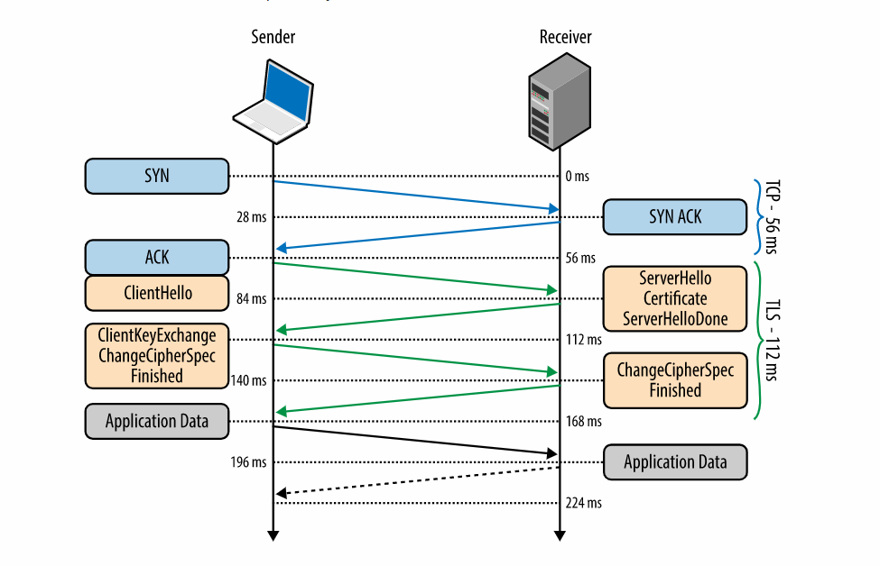
TLS - Handshake
0 ms - TLS runs over a reliable transport (TCP), which means that we must first complete the TCP three-way handshake, which takes one full roundtrip.
56 ms - With the TCP connection in place, the client sends several specifications in plain text, such as the version of the TLS protocol it is running, the list of supported ciphersuites and other TLS options it may want to use.
84 ms - The server picks the TLS protocol version for further communication, decides on a ciphersuite from the list provided by the client, attaches its certificate (including its public key), and sends the response back to the client.

Slide 32
TLS - Handshake
112 ms -Assuming both sides are able to negotiate a common version and cipher, and the client is happy with the certificate provided by the server, the client initiates either the RSA or the Diffie-Hellman key exchange, which is used to establish the symmetric key for the session.
140 ms -The server processes the key exchange parameters sent by the client, checks message integrity by verifying the MAC, and returns an encrypted Finished message back to the client.
168 ms -The client decrypts the message with the negotiated symmetric key, verifies the MAC, and if all is well, then the tunnel is established and application data can now be sent.

Slide 33
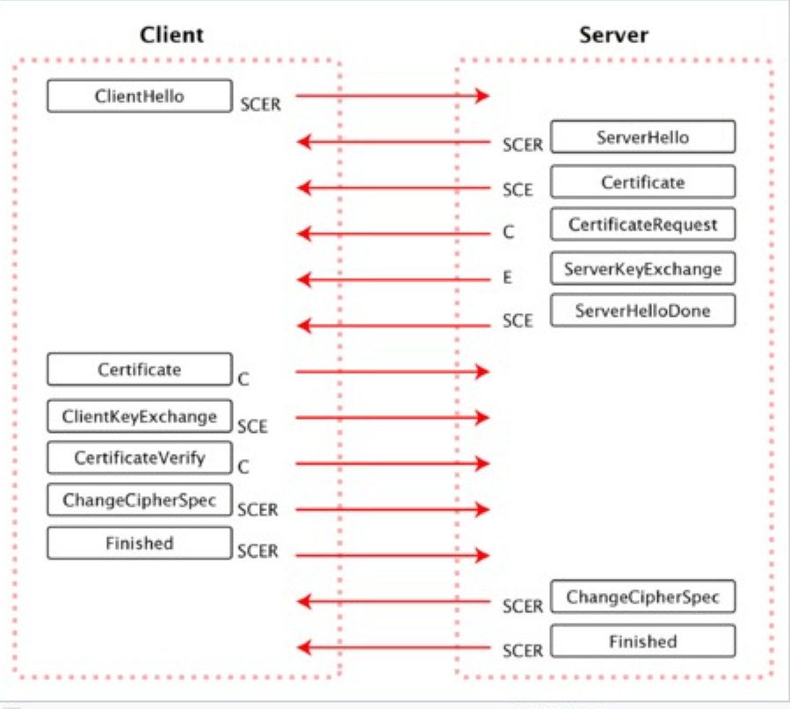

Slide 34
HTTPS
DNS over HTTPS
DNS
HTTPS
HTTP
TLS
HTTP1.0
HTTP1.1
HTTP2.0

Slide 35
HTTPS
HTTPS stands for Hypertext Transfer Protocol Secure.
It is the protocol where encrypted HTTP data is transferred over a secure connection, by using secure connection such as TLS or SSL.
The privacy and integrity of data are maintained and authentication of websites is also validated.
It uses port 443
HTTPS encryption is done bi-directionally, which means that the data is encrypted at both the client and server sides.

Slide 36
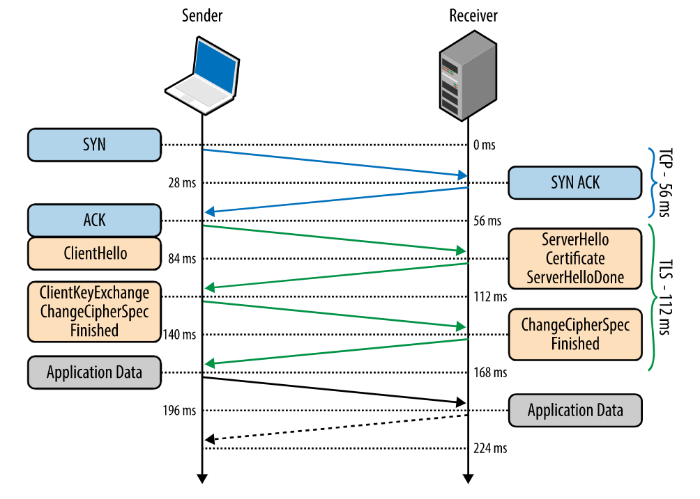
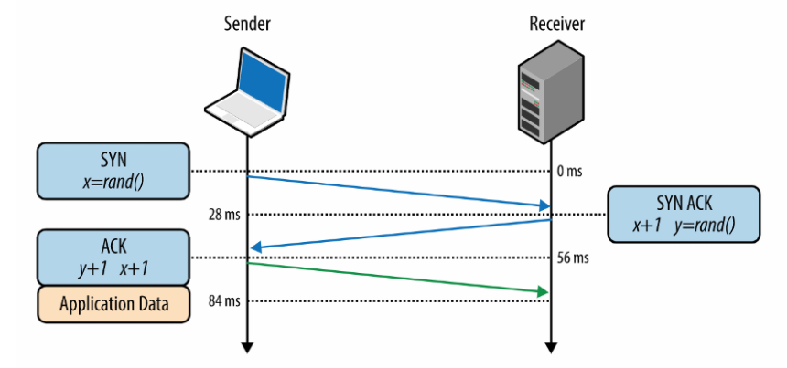
HTTPS vs HTTP

Slide 37
DoT???

Slide 38
DoT- DNS over TLS
TLS protocol
Port 853 to differentiate these request from
The unencrypted DNS requests
Because of the TLS protocol, this request is completely encrypted so your ISP or anyone between can’t inspect this traffic.
DNS over TLS is easy to detect because it use the 853 port

Slide 39
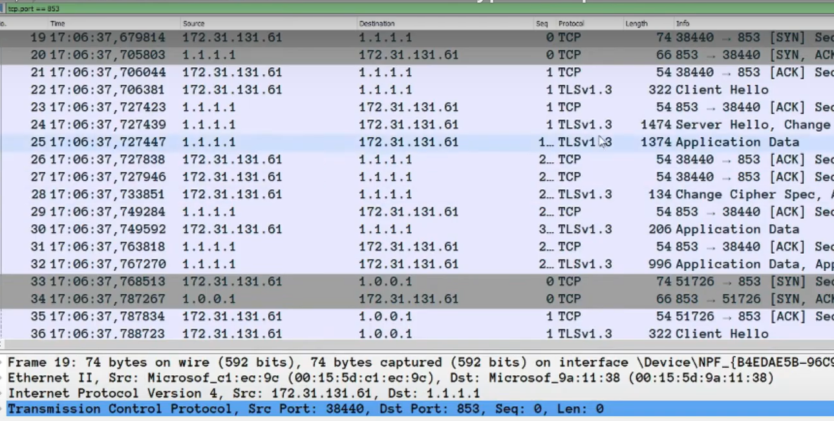
DoT – Wireshark

Slide 40
DNS
Packets
DoT
HTTP
HTTPS
DoH
link
link
link
IP
Src: Client
Dest: Resolver
link
IP
Src: Client
Dest: Resolver
link
IP
Src: Client
Dest: Web Server
IP
Src: Client
Dest: Resolver
IP
Src: Client
Dest: Web Server
TCP – Port 443
Unencrypted
TCP – Port 853
Unencrypted
TCP – Port 443
TLS
Encrypted
Encrypted
Encrypted
UDP - Port 53
TLS
TCP – Port 80
TLS
HTTP GET/POST
DNS query
DNS query
HTTP GET/POST
HTTP GET/POST
DNS query

Slide 41
DoH
DNS over HTTPS
DNS
HTTPS
HTTP
TLS
HTTP1.0
HTTP1.1
HTTP2.0

Slide 42
DoH - DNS over HTTPS
When you want to browse a web site or access server by name, your computer will send out a DNS request to your private home router. That will mainly ask your ISP to give you the IP address of the destination host, this is done by a DNS request and the package is completely unencrypted, that means your ISP or anyone between your computer and the destination DNS server can read and inspect the traffic and can see which website you are browsing or which servers you are trying to resolve.
The main goal of DNS encryption is to increase security and privacy.

Slide 43
DoH - DNS over HTTPS
link
IP
Src: Client
Dest: Resolver
TCP – Port 443
TLS
The web server need to take care of differentiating
http requests and DNS requests
Its hard to differentiate between a normal https connection and a DNS request and this is also the main disadvantage and the main point of DOH.
Encrypted
HTTP GET/POST
DNS query

Slide 44
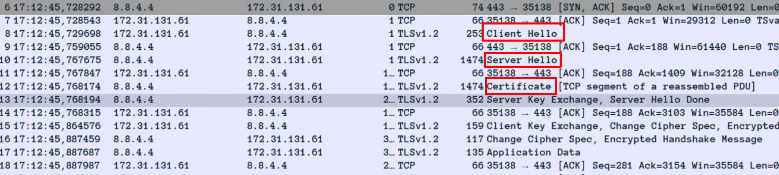
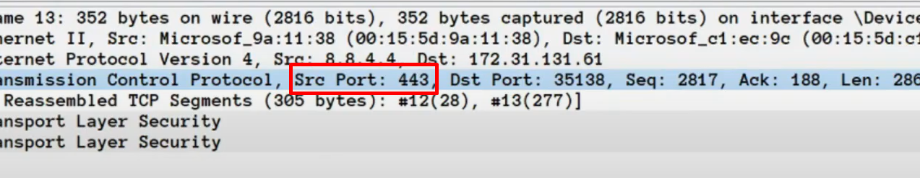
DoH - Wireshark

Slide 45
See More
DNS Packet Structure - https://www2.cs.duke.edu/courses/fall16/compsci356/DNS/DNS-primer.pdf
Encrypted & unencrypted DNS - https://blog.cloudflare.com/dns-encryption-explained/
TLS - https://hpbn.co/transport-layer-security-tls/#tls-handshake-protocol
TLS key exchange - https://www.youtube.com/watch?v=IE0QLCcOr0I
DoT & DoH - https://www.youtube.com/watch?v=6hLHMA_tJ8k
HTTPS - https://www.youtube.com/watch?v=T4Df5_cojAs
Segments & Packets & Frames - https://www.youtube.com/watch?v=P5jC8D5zndc

